Slide 1


CSE3150 – Front-end Full Stack Development
School of Computer Science Engineering and Information Science

Slide 2
Module 2 - Responsive web design
JavaScript – Core syntax, HTML DOM, objects, classes, Async; BootStrap for Responsive Web Design; Ajax and jQuery Introduction

Slide 3
What is Javascript?
a lightweight programming language ("scripting language")
used to make web pages interactive
insert dynamic text into HTML (ex: user name)
react to events (ex: page load user click)
get information about a user's computer (ex: browser type)
perform calculations on user's computer (ex: form validation)

Slide 4

Javascript vs Java
interpreted, not compiled
more relaxed syntax and rules
fewer and "looser" data types
variables don't need to be declared
errors often silent (few exceptions)
key construct is the function rather than the class
"first-class" functions are used in many situations
contained within a web page and integrates with its HTML/CSS content

Slide 5
Linking to a JavaScript file: script
<script src="filename" type="text/javascript">
</script>
script tag should be placed in HTML page's head
script code is stored in a separate .js file
JS code can be placed directly in the HTML file's body or head (like CSS)

Slide 6
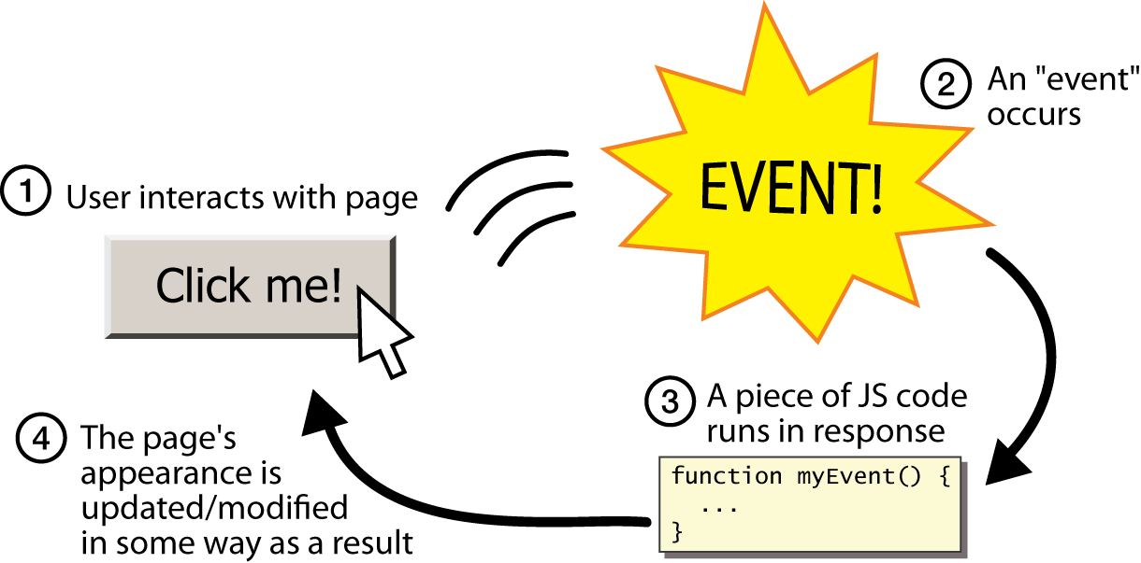
Event-driven programming

Slide 7
Event-driven programming
you are used to programs start with a main method (or implicit main like in PHP)
JavaScript programs instead wait for user actions called events and respond to them
event-driven programming: writing programs driven by user events
Let's write a page with a clickable button that pops up a "Hello, World" window...

Slide 8
Event handlers
<element attributes onclick="function();">...
<button onclick="myFunction();">Click me!</button>
JavaScript functions can be set as event handlers
when you interact with the element, the function will execute
onclick is just one of many event HTML attributes we'll use
but popping up an alert window is disruptive and annoying
A better user experience would be to have the message appear on the page...

Slide 9
JavaScript functions
function name() {
statement ;
statement ;
...
statement ;
} JS
function myFunction() {
alert("Hello!");
alert("How are you?");
} JS
the above could be the contents of example.js linked to our HTML page
statements placed into functions can be evaluated in response to user events

Slide 10

The HTML DOM (Document Object Model)
Document Object Model (DOM) is a platform and language-neutral interface that allows programs and scripts to dynamically access and update the content, structure, and style of a document.

Slide 11
The HTML elements as objects
The properties of all HTML elements
The methods to access all HTML elements
The events for all HTML elements

Slide 12
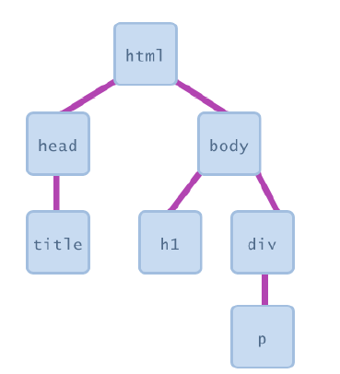
Document Object Model (DOM)
JavaScript can change all the HTML elements in the page
JavaScript can change all the HTML attributes in the page
JavaScript can change all the CSS styles in the page
JavaScript can remove existing HTML elements and attributes
JavaScript can add new HTML elements and attributes
JavaScript can react to all existing HTML events in the page
JavaScript can create new HTML events in the page

Slide 13
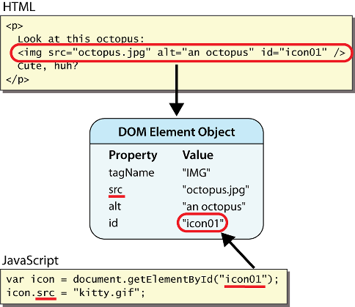
DOM element objects
Notes:
every element on the page has a corresponding DOM object access/modify the attributes of the DOM object with objectName.attributeName

Slide 14
Accessing elements: document.getElementById
document.getElementById returns the DOM object for an element with a given id
can change the text inside most elements by setting the innerHTML property
can change the text in form controls by setting the value property

Slide 15
Accessing elements: document.getElementById
In the DOM, all HTML elements are defined as objects.
<body> <p id="demo"></p>
<script> document.getElementById("demo").innerHTML = "Hello World!"; </script>
</body>
The innerHTML property is useful for getting or replacing the content of HTML elements.

Slide 16
Accessing elements: document.getElementById
var name = document.getElementById("id");
<button onclick="changeText();">Click me!</button>
<span id="output">replace me</span>
<input id="textbox" type="text" />
</body>
<script>
function changeText() {
var span = document.getElementById("output");
var textBox = document.getElementById("textbox");
textbox.style.color = "red";
}
</script>
Notes:
span.innerHTML = textBox.value;

Slide 17
Changing element style: element.style
Attribute | Property or style object
color | color
padding | padding
background-color | backgroundColor
border-top-width | borderTopWidth
Font size | fontSize
Font famiy | fontFamily

Slide 18
function changeText() {
//grab or initialize text here
// font styles added by JS:
text.style.fontSize = "13pt";
text.style.fontFamily = "Comic Sans MS";
text.style.color = "red"; // or pink?
} JS

Slide 19
Reading Properties with JavaScript
Sample HTML
Example 1 returns "ul"
Example 2 returns "null"
Example 3 returns "li"
Example 4 returns "text"
A text node below the "li" which holds the actual text data as its value
Example 5 returns " Item 1 "
<ul id="t1">
<li> Item 1 </li>
</ul>
1. document.getElementById('t1').nodeName
2. document.getElementById('t1').nodeValue
3. document.getElementById('t1').firstChild.nodeName
4. document.getElementById('t1').firstChild.firstChild.nodeName
5. document.getElementById('t1').firstChild.firstChild.nodeValue

Slide 20
JavaScript Output
JavaScript can "display" data in different ways:
Writing into an HTML element, using innerHTML.
Writing into the HTML output using document.write().
Writing into an alert box, using window.alert().
Writing into the browser console, using console.log().

Slide 21
Using innerHTML
To access an HTML element, JavaScript can use the document.getElementById(id) method.
The id attribute defines the HTML element. The innerHTML property defines the HTML content:
<html> <body> <h1>My First Web Page</h1> <p>My First Paragraph</p> <p id="demo"></p> <script> document.getElementById("demo").innerHTML = 5 + 6; </script> </body> </html

Slide 22
Using document.write()
<script> document.write(5 + 6); </script>
<button type="button" onclick="document.write(5 + 6)">
Try it</button>

Slide 23
Displaying text
The document.write() method writes a string of text to the browser
<script type="text/javascript">
<!--
document.write("<h1>Hello, world!</h1>");
//-->
</script>

Slide 24
document.write()
Ends in a semicolon
document.write("<h1>Hello,world!</h1>");
Enclosed in quotes -- denotes a "string"

Slide 25
Using window.alert()
<script>
window.alert(7 +12);
</script>
Using console.log()
For debugging purposes, you can call the console.log() method in the browser to display data.

Slide 26
Comments in JavaScript
Two types of comments
Single line
Uses two forward slashes (i.e. //)
Multiple line
Uses /* and */

Slide 27
Language Basics
JavaScript is case sensitive
onClick, ONCLICK, … are HTML, thus not case-sensitive
Statements terminated by returns or semi-colons
x = x+1;
“Blocks” of statements enclosed in { …}
Variables
Define using the var statement
Define implicitly by its first use, which must be an assignment
Implicit defn has global scope, even if occurs in nested scope!

Slide 28
JavaScript Primitive Datatypes
Boolean: true and false
Number: 64-bit floating point
Similar to Java double and Double
No integer type
Special values NaN (not a number) and Infinity
String: sequence of zero or more Unicode chars
No separate character type (just strings of length 1)
Literal strings using ' or " characters (must match)
Special objects: null and undefined

Slide 29
4 Ways to Declare a JavaScript Variable
Using var
Using let
Using const
Using nothing

Slide 30
Variables
var name = expression; JS
var name = expression; JS
var name = expression; JS
var clientName = "Connie Client";
var age = 32;
var weight = 127.4; JS
var clientName = "Connie Client";
var age = 32;
var weight = 127.4; JS
var clientName = "Connie Client";
var age = 32;
var weight = 127.4; JS
variables are declared with the var keyword (case sensitive)
types are not specified, but JS does have types ("loosely typed")
Number, Boolean, String, Array, Object, Function, Null, Undefined
can find out a variable's type by calling typeof()

Slide 31
let x = 5;
let y = 6;
let z = x + y;
When to Use?
Always declare JavaScript variables with var,let, or const.
The let and const keywords were added to JavaScript in 2015.
If you want your code to run in older browsers, you must use var.
If you want a general rule: always declare variables with const.
If you think the value of the variable can change, use let.
const price1 = 5;
const price2 = 6;
let total = price1 + price2;

Slide 32
Number type
var enrollment = 99;
var medianGrade = 2.8;
var credits = 5 + 4 + (2 * 3); JS
integers and real numbers are the same type (no int vs. double)
same operators: + - * / % ++ -- = += -= *= /= %=
similar precedence to Java
many operators auto-convert types: "2" * 3 is 6

Slide 33
Comments (same as Java)
// single-line comment
/* multi-line comment */ JS
identical to Java's comment syntax
recall: 4 comment syntaxes
HTML: <!-- comment -->
CSS/JS/PHP: /* comment */
Java/JS/PHP: // comment
PHP: # comment

Slide 34
Math object
var rand1to10 = Math.floor(Math.random() * 10 + 1);
var three = Math.floor(Math.PI); JS
methods: abs, ceil, cos, floor, log, max, min, pow, random, round, sin, sqrt, tan
properties: E, PI

Slide 35
// Numbers: let length = 16; let weight = 7.5; // Strings: let color = "Yellow"; let lastName = "Johnson"; // Booleans let x = true; let y = false; // Object: const person = {firstName:"John", lastName:"Doe"}; // Array object: const cars = ["Saab", "Volvo", "BMW"]; // Date object: const date = new Date("2022-03-25");

Slide 36
Special values: null and undefined
var ned = null;
var benson = 9;
// at this point in the code,
// ned is null
// benson's 9
// caroline is undefined JS
undefined : has not been declared, does not exist
null : exists, but was specifically assigned an empty or null value
Why does JavaScript have both of these?

Slide 37
Operators (self study)
Refer all operators you studied in java

Slide 38
Logical operators
> < >= <= && || ! == != === !==
most logical operators automatically convert types:
5 < "7" is true
42 == 42.0 is true
"5.0" == 5 is true
=== and !== are strict equality tests; checks both type and value
"5.0" === 5 is false

Slide 39
JavaScript Strings
<p>The length of the string is:</p>
<p id="demo"></p>
<script>
let text = "ABCDEFGHIJKLMNOPQRSTUVWXYZ";
document.getElementById("demo").innerHTML = text.length;
</script>

Slide 40
JavaScript Functions
function name(parameter1, parameter2, parameter3) { // code to be executed }
Function Invocation
The code inside the function will execute when "something" invokes (calls) the function:
When an event occurs (when a user clicks a button)
When it is invoked (called) from JavaScript code
Automatically (self invoked)

Slide 41
Example 1
<p id="demo"></p>
<script>
var x = myFunction(4, 3);
document.getElementById("demo").innerHTML = x;
function myFunction(a, b) {
return a * b;
}
</script>

Slide 42
Example 2
<p id="demo"></p>
<script>
document.getElementById("demo").innerHTML =
"The temperature is " + toCelsius(77) + " Celsius";
function toCelsius(fahrenheit) {
return (5/9) * (fahrenheit-32);
}
</script>

Slide 43
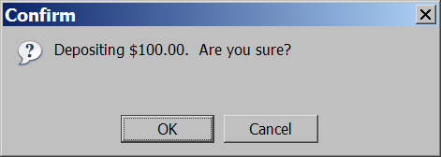
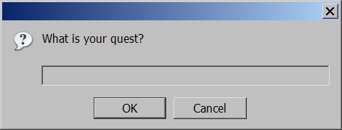
Popup boxes
alert("message"); // message
confirm("message"); // returns true or false
prompt("message"); // returns user input string JS

Slide 44
JavaScript Objects
Real Life Objects, Properties, and Methods
In real life, a student is an object.
Student can have properties name, roll_no., marks, phone_num, age…
Student can have methods to operate on properties like Calcualte_cgpa(), diplayInfo()….
All student have same properties, values may change
Assume car is an object

Slide 45
let car = "Fiat";
Objects are variables too. But objects can contain many values.
const car = {type:"Fiat", model:"500", color:"white"};
The values are written as name:value pairs (name and value separated by a colon).

Slide 46
<p id="demo"></p>
<script>
// Create an object:
const person = {
firstName: "John",
lastName: "Doe",
age: 50,
eyeColor: "blue"
};
// Display some data from the object:
document.getElementById("demo").innerHTML =
person.firstName + " is " + person.age + " years old.";
</script>

Slide 47
JavaScript Events
HTML events are "things" that happen to HTML elements.
When JavaScript is used in HTML pages, JavaScript can "react" on these events.
HTML Events
An HTML event can be something the browser does, or something a user does.
Here are some examples of HTML events:
An HTML web page has finished loading
An HTML input field was changed
An HTML button was clicked

Slide 48
HTML allows event handler attributes, with JavaScript code, to be added to HTML elements.
<element event='some JavaScript’>
<body>
<button onclick="document.getElementById('demo').innerHTML=Date()"> The time is? </button>
<p id="demo"></p>
</body>

Slide 49
Try this
<button onclick="displayDate()">The time is?</button>
<script>
function displayDate() {
document.getElementById("demo").innerHTML = Date();
} </script>
<p id="demo"></p>

Slide 50
Objects use names to access its "members".
In this example, person.firstName returns John:
<p id="demo"></p>
<script>
const person = {firstName:"John", lastName:"Doe", age:46};
document.getElementById("demo").innerHTML = person.firstName;
</script>

Slide 51
JavaScript Arrays
Syntax:
const array_name = [item1, item2, ...];
const cars = [ "Saab", "Volvo", "BMW" ];
Accessing Array Elements
const cars = ["Saab", "Volvo", "BMW"]; let car = cars[0]; //Saab

Slide 52
const fruits = ["Banana", "Orange", "Apple", "Mango"]; let length = fruits.length; //4
Looping Array Elements
<p id="demo"></p>
<script>
const fruits = ["Banana", "Orange", "Apple", "Mango"];
let text = "<ul>";
fruits.forEach(myFunction);
text += "</ul>";
document.getElementById("demo").innerHTML = text;
function myFunction(value) {
text += "<li>" + value + "</li>";
} </script>

Slide 53
<p id="demo"></p>
<script>
const numbers = [65, 44, 12, 4];
numbers.forEach(myFunction)
document.getElementById("demo").innerHTML = numbers;
function myFunction(item, index, arr) {
arr[index] = item * 10;
}
</script>

Slide 54
Adding elements to array
const fruits = ["Banana", "Orange", "Apple"]; fruits.push("Lemon");
OR
const fruits = ["Banana", "Orange", "Apple"]; fruits[fruits.length] = "Lemon";
JavaScript does not support associative arrays.
You should use objects when you want the element names to be strings (text).
You should use arrays when you want the element names to be numbers.

Slide 55
Array methods
var a = ["Stef", "Jason"]; // Stef, Jason
a.push("Brian"); // Stef, Jason, Brian
a.unshift("Kelly"); // Kelly, Stef, Jason, Brian
a.pop(); // Kelly, Stef, Jason
a.shift(); // Stef, Jason
a.sort(); // Jason, Stef
array serves as many data structures: list, queue, stack, ...
methods: concat, join, pop, push, reverse, shift, slice, sort, splice, toString, unshift
push and pop add / remove from back
unshift and shift add / remove from front
shift and pop return the element that is removed

Slide 56
if/else statement (same as Java)
if (condition) {
statements;
} else if (condition) {
statements;
} else {
statements;
}
JS
identical structure to Java's if/else statement
JavaScript allows almost anything as a condition

Slide 57
for loop (same as Java)
var sum = 0;
for (var i = 0; i < 100; i++) {
sum = sum + i;
}
var s1 = "hello";
var s2 = "";
for (var i = 0; i < s.length; i++) {
s2 += s1.charAt(i) + s1.charAt(i);
} // s2 stores "hheelllloo"
<script>
const cars = ["BMW", "Volvo", "Saab", "Ford", "Fiat", "Audi"];
let text = "";
for (let i = 0; i < cars.length; i++) {
text += cars[i] + "<br>";
}
document.getElementById("demo").innerHTML = text;
</script>

Slide 58
The For In Loop
for (key in object) { // code block to be executed }
const person = {fname:"John", lname:"Doe", age:25}; let text = ""; for (let x in person) { text += person[x]; }
Output for text is John Doe 25

Slide 59
The For Of Loop
for (variable of iterable) { // code block to be executed }
const cars = ["BMW", "Volvo", "Mini"]; let text = ""; for (let x of cars) { text += x; } // BMW Volvo Mini
let language = "JavaScript";
let text = "";
for (let x of language) {
text += x ; } // JavaScript

Slide 60
while loops (same as Java)
while (condition) {
statements;
} JS
do {
statements;
} while (condition); JS
break and continue keywords also behave as in Java

Slide 61
String type
var s = "Connie Client";
var fName = s.substring(0, s.indexOf(" ")); // "Connie"
var len = s.length; // 13
var s2 = 'Melvin Merchant'; JS
methods: charAt, charCodeAt, fromCharCode, indexOf, lastIndexOf, replace, split, substring, toLowerCase, toUpperCase
charAt returns a one-letter String (there is no char type)
length property (not a method as in Java)
Strings can be specified with "" or ''
concatenation with + :
1 + 1 is 2, but "1" + 1 is "11"

Slide 62


